Slide 1
TamaFit
Tamagotchi Fitness app

Slide 2
The Overall Concept
TamaFit is a simple fitness app that makes use of Tamagotchi characters as user avatars.
Users can select and change their desired avatars
Users can add, edit, and delete their workout logs
Logs are displayed in descending chronological order by workout date
Our original concept was more ambitious, incorporating tamagotchi functionality in relation to the frequency of workouts logged by the user. The avatar was meant to show the user visually whether or not the user is exercising.

Slide 3
The motivation for TamaFit’s development
We started by researching various innovative development projects. We ended up taking inspiration from Tamarafi, created by students at Fullstack Academy in New York. We all thought it could work well for our project requirements and be a great use of using a database. The scope of this app and the potential for adding features was massive. We began by brainstorming what it would take to achieve a MVP. With limited time available we were able to create a great looking app that has a lot of room to grow.

Slide 4
Our design process
Design started with a group brainstorming session to decide on the app layout & functionality.
Draw.io was used for wireframing
The app design was altered as needed to accomodate needed functionality.
TamaFit was originally to be 2 separate web pages. The ‘main page’ that displays user info, avatar and ability to log data. The second page would have been a ‘social club’ with a leader board so the user can compare their exercises against other users. There was going to a message board to interact with other users.
To better implement TamaFit functionality and improve the user experience, the app now has 7 web pages.

Slide 5
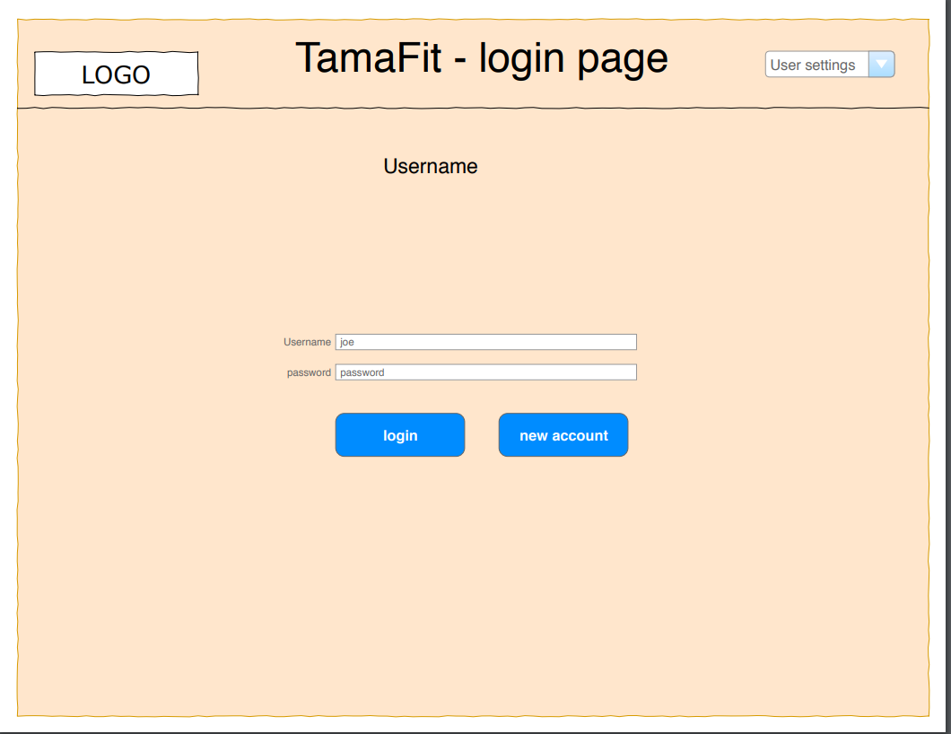

Slide 6
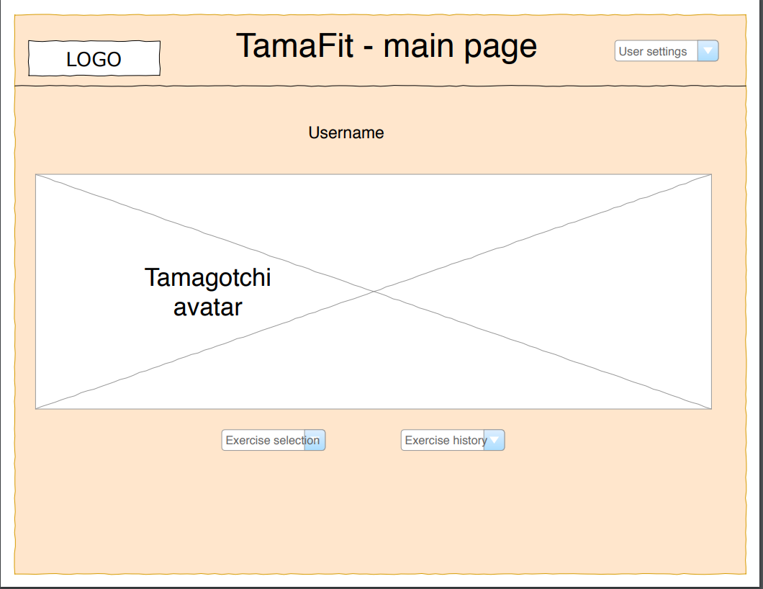

Slide 7
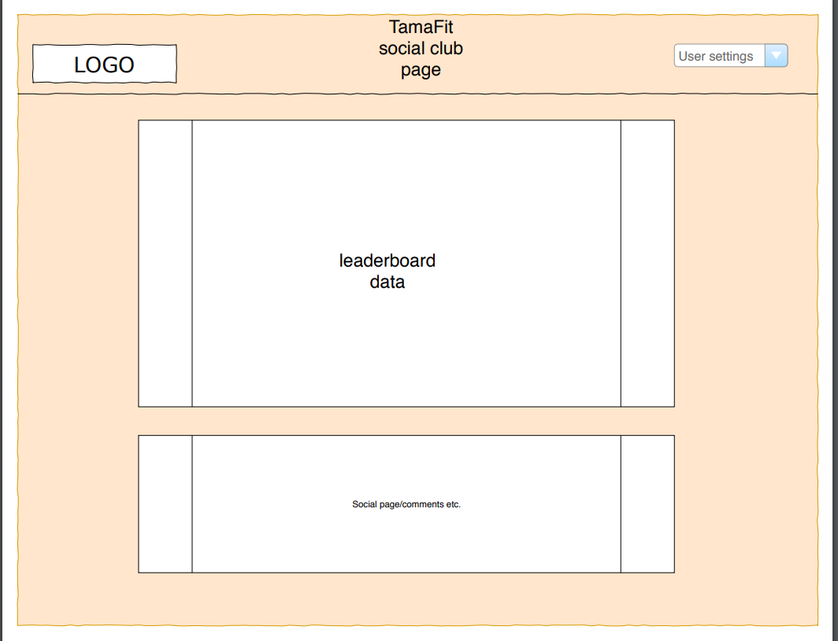

Slide 8
The technologies used: front-end
HTML/CSS
JavaScript
Handlebars templating engine
Bootstrap
media queries for mobile responsiveness
Google Fonts
Moment.js for setting calendar to current date
animate.css npm library for animations

Slide 9
animate.css
https://daneden.github.io/animate.css/
Simple animations using css classes
Install via npm: npm i animate.css --save
Add link to the stylesheet in the main.handlebars file: <link rel="stylesheet" href="animate.min.css">
Add the classes animated and the animation you want to apply to the element (such as) zoomOutUp
Has over 70 animations available

Slide 10
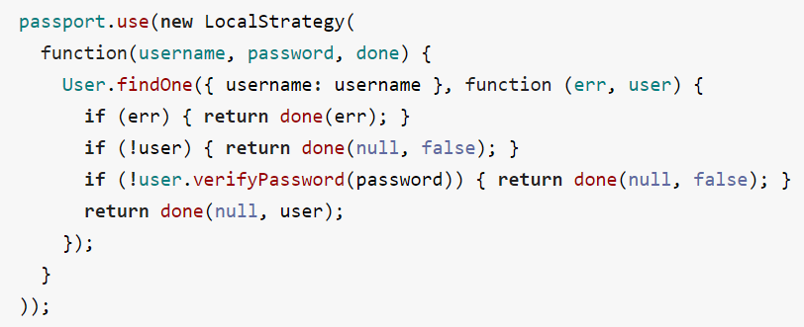
passport (npm package)
Using strategies (example below), user authentication such as email and password can be achieved

Slide 11
The technologies used: back-end
Express
Node
Sequelize
Heroku
Passport: Express-compatible authentication middleware for Node.js
Bcrypt-nodejs: library that hashes passwords

Slide 12
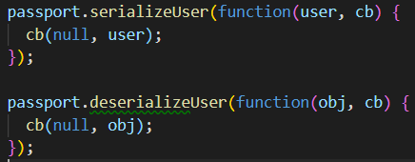
passport (npm package)
Can maintain persistent authenticated sessions across HTTP requests by serializing and deserializing user

Slide 13
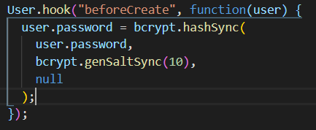
bcrypt-nodejs (npm package)
In cryptography, salt is random data used an additional input to a one-way function to hash data, such as a password.
Passwords are automatically hashed prior to the user account being created.

Slide 14

bcrypt-nodejs (npm package)
During the login process, the unhashed password is checked against the stored hashed password safeguarded in our database using the .compareSync() method

Slide 15
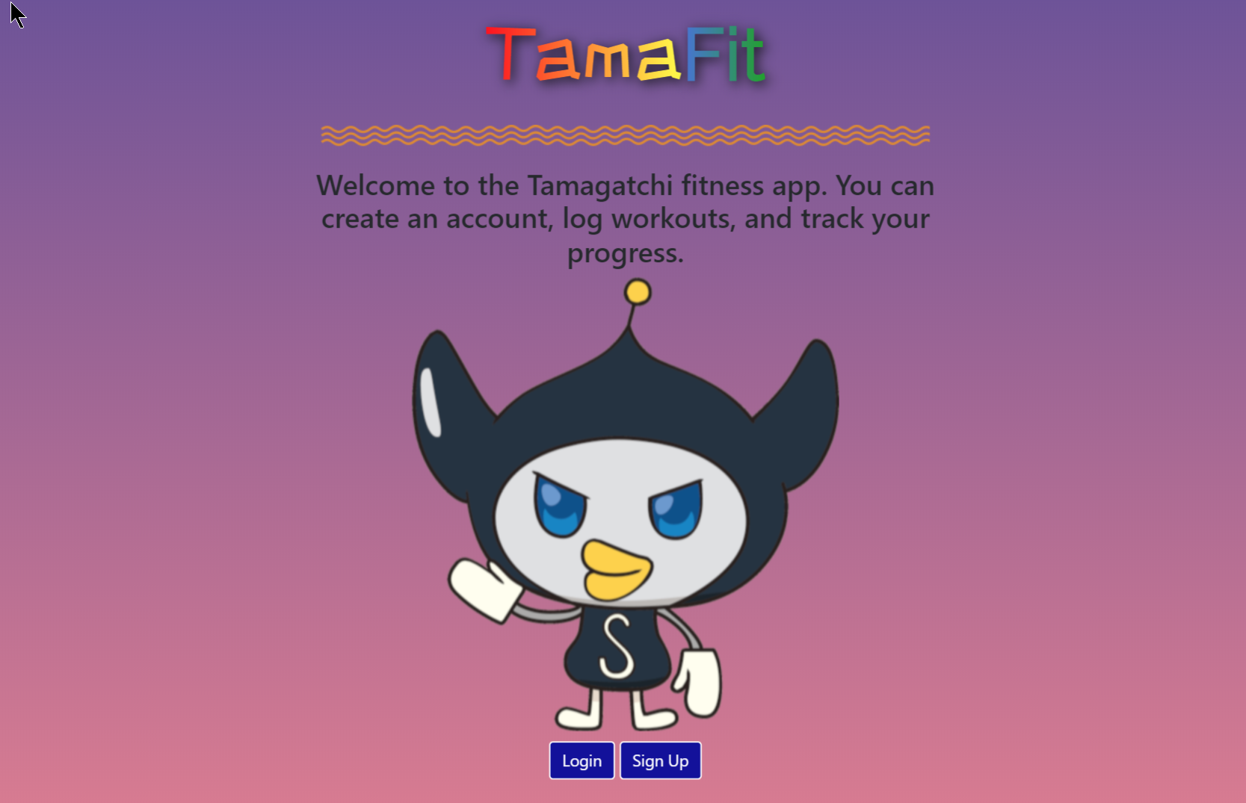
TamaFit demo

Slide 16
Directions for future development
Reward system for users who consistently log exercises
Give users +1 for each day an exercise is logged/ -1 for days missed
Make avatar get smaller/sadder for each day user fails to log an exercise
Track and display statistics of workout log trends
Implement page with leaderboard/social media/comments
Go to logs based on date by clicking on a calendar display
Options to edit password, name, email, reset password or delete account
Option for in-app customizable avatar or user avatar upload
Array of tailored quotes that avatars will say to the user

